Slide 1



CLIMATE - HYDROGEOLOGY
Geophysical and Hydrogeological Analysis of the Napu Aquifer
Florence Tanui, Gilbert Ouma, Daniel Olago
Turkana Stakeholder Workshop - Thursday 15 February, 2018

Slide 2

OUTLINE
Regional Context
Local Context
Research Objectives
Conceptual Framework
Hydrogeological Characteristics
Basic Conceptual Model
Planned Activities

Slide 3
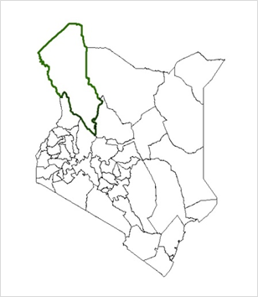
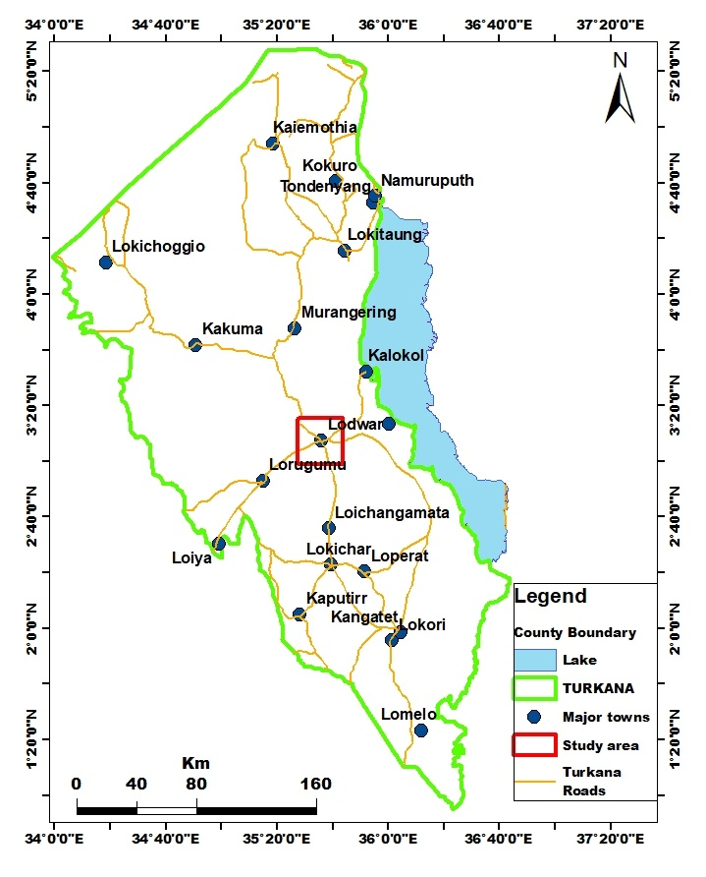
REGIONAL CONTEXT OF STUDY AREA
Study area is located Turkana County in the north western part of Kenya
Lodwar town, the headquarters of Turkana County depends largely on groundwater for water supply
Most of the existing boreholes are along Rivers and laggas where they are possibly recharged
Most boreholes experience very low yields during dry seasons and some wells have been reported dry

Slide 4
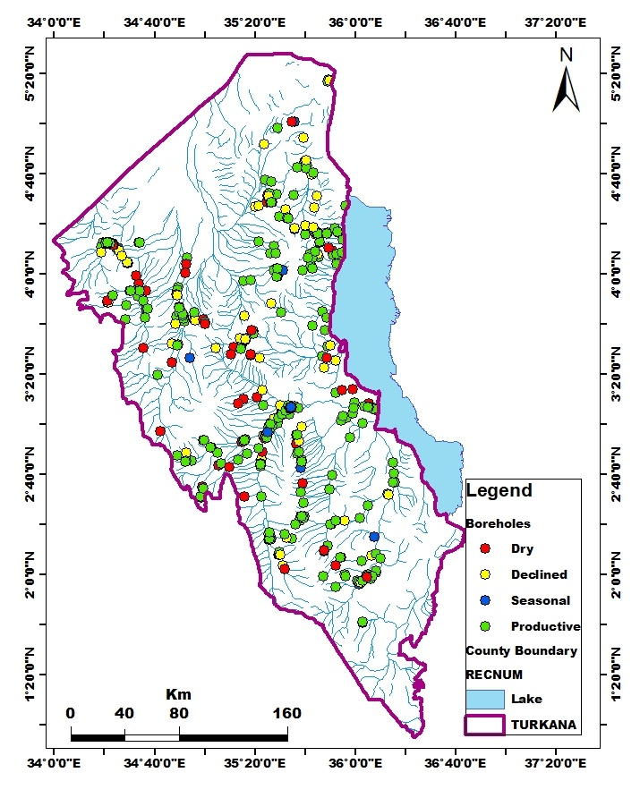
GROUNDWATER SITUATION IN TURKANA
GROUNDWATER SITUATION IN TURKANA
A total of 252 boreholes were assessed for their availability for abstraction
About 14% of initially productive boreholes have dried up
Boreholes with declined yields are 16% and seasonal wells are 3%
68% of the boreholes have not experienced significant drop in yields.

Slide 5
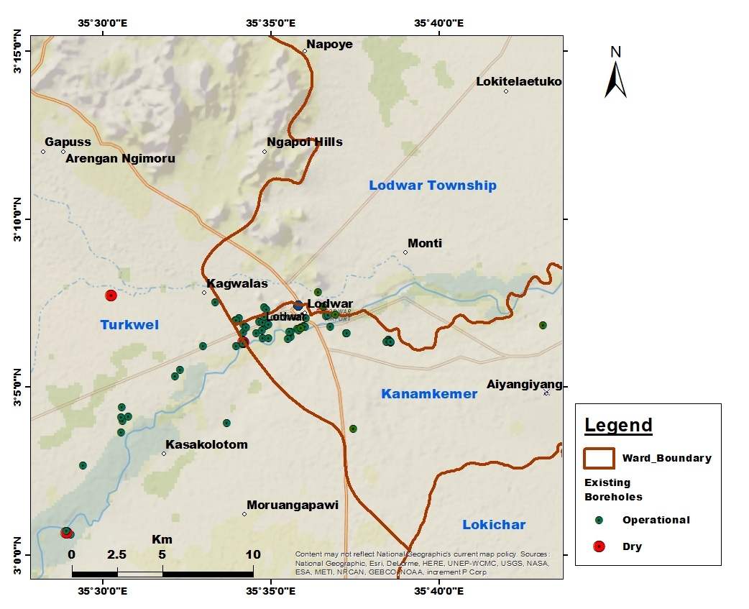
STUDY AREA: LODWAR TOWN & ENVIRONS
The study covers parts of Turkwel, Kanamkemer and Lodwar Township wards
The area is 900 km²
The major landforms dominating the area are hills, plains and river valleys
The hills dominate the north-western section and constitute 10% of the total surface area with a maximum elevation of 900 m asl.
The plains cover about 70% of the area with an average elevation of 500 m asl.
The river valley has an average elevation of 200-350 m asl.

Slide 6
RESEARCH OBJECTIVES
Objective 1: To determine the hydrogeological characteristics of the Napu aquifer
Objective 2: To characterise the aquifer hydrogeochemistry and its susceptibility to pollution
Objective 3: To examine interaction between rainfall, surface water and groundwater and recharge characteristics using isotopic and Water Table Fluctuation (WFT) methods

Slide 7
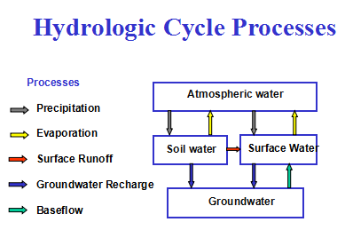
CONCEPTUAL FRAMEWORK

Slide 8
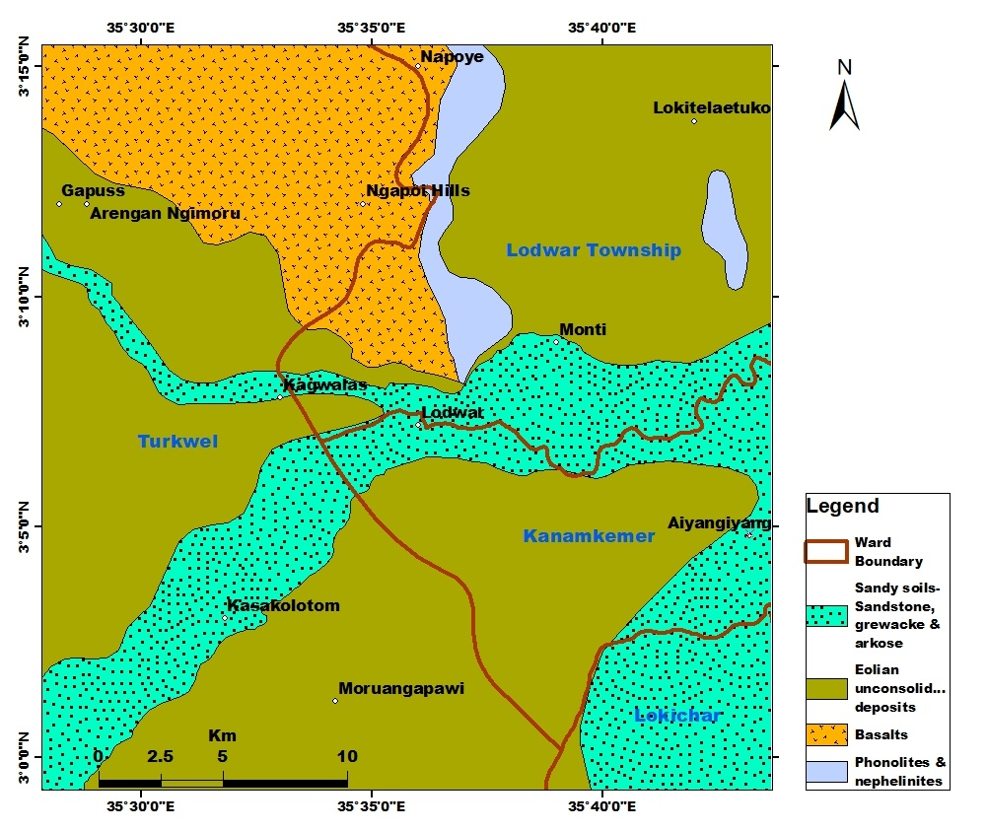
GEOLOGY
Geologic Formations
Alluvial deposits- (sandstone, greywacke & arkose)
Unconsolidated Eolian Deposits
Volcanic rocks - basalts, phonolites, nephelinites & rhyolites)
Sedimentary rocks – Turkana Grits (Grits, sandstones & limestones)
Undifferentiated basement system – (gneisses, schist and marbles)

Slide 9
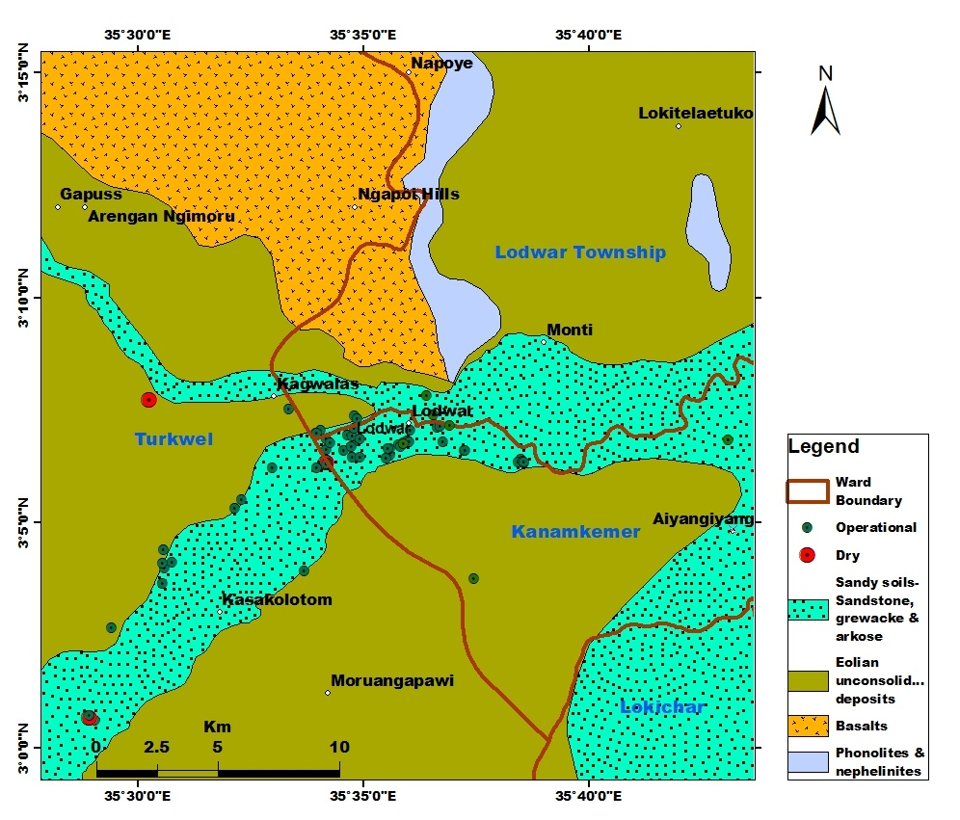
EXISTING BOREHOLES
About 40 boreholes have been drilled within Lodwar town
Most reliable boreholes are those found within the river valleys of Turkwel
The boreholes depths are between 15 and 80m
Boreholes in the plains have been drilled up to 130 m depth

Slide 10
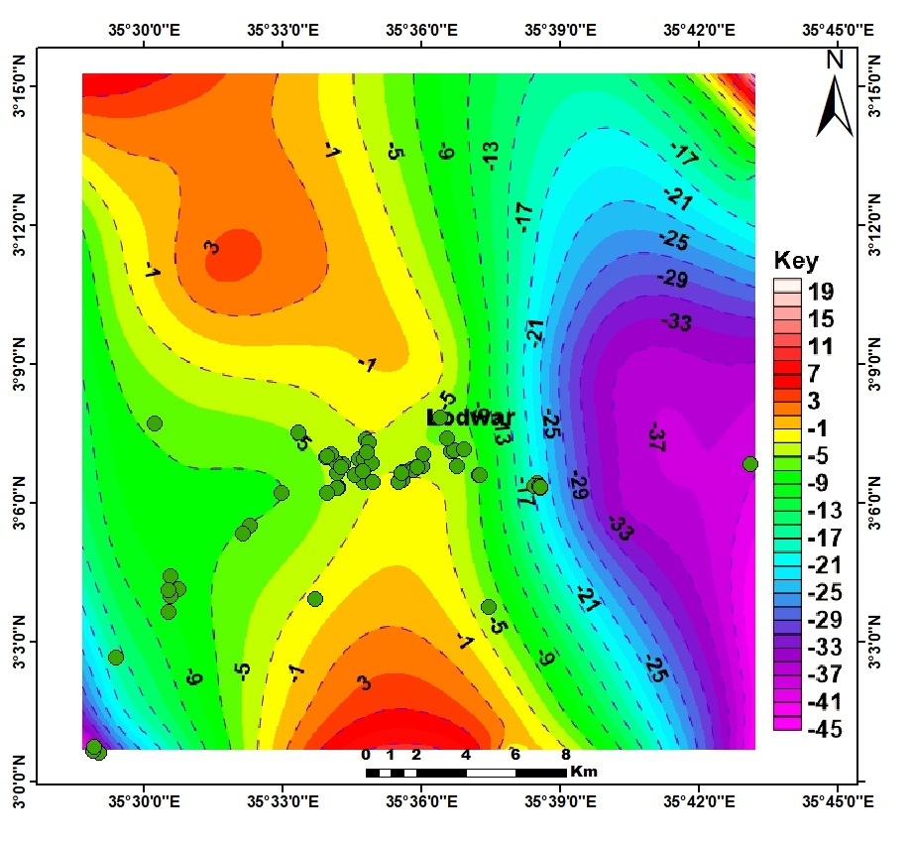
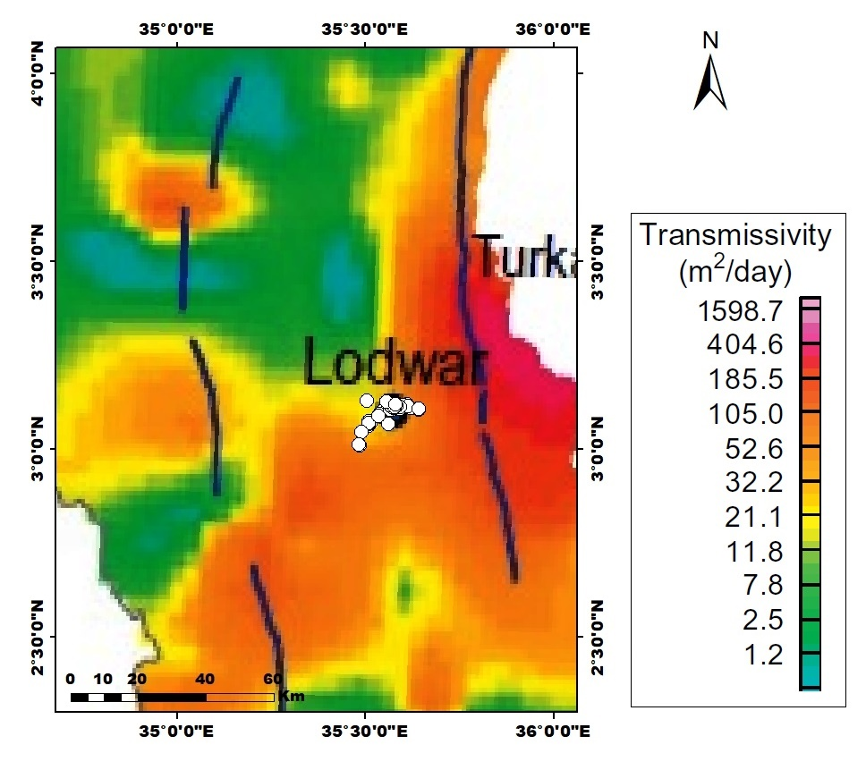
BOUGUER GRAVITY & TRANSMISSIVITY
Boreholes are found in areas of low gravity anomalies (-5 to -13) with medium transmissivity values between 21 to 105 m²/day
The values of transmissivity indicate medium to high groundwater potential in the area

Slide 11
EVIDENCE OF DECLINING YIELDS
12 boreholes mapped during the water audit were analysed for yield-trends
Declining trend was observed in all the boreholes twelve boreholes where Bh 2B is already dry

Slide 12
WATER QUALITY: SURFACE WATER
SW water quality indicate high turbidity values of 464 and 829 N.T.U in Turkwel River and Kerio River, respectively, against a maximum value of 5 N.T.U (KEBS & WHO)
Total suspended solids (TSS), sulphate, and chloride is higher in the river water than in the springs
Total dissolved solids (TDS) and conductivity values are higher in the spring waters as well as in the Turkwel River as compared to Kerio River

Slide 13
WATER QUALITY ANALYSIS:
REGIONAL BOREHOLES
The turbidity of LOWASCO borehole, Lotubue, Lopeduru, Nomoruakwan and Kalokol community boreholes exceed the recommended value of 5 N.T.U by WHO and KEBS = suggests dynamic & tightly coupled connection with the rivers/laggas
The chloride content of Kalokol community borehole (525 mg/l) and Nakwin borehole (585 mg/l) is above the WHO and KEBS drinking water quality limit of 250 mg/l

Slide 14
WATER QUALITY: NAPU BOREHOLES
Results shows high alkalinity of 516 mg/l and iron value of 0.73 mg/l for the Napuu Mission borehole.
High alkalinity, High turbidity and high TDS is observed in both the surface water and the groundwater = active remobilisation of dispersed evaporative salts/fine clays within surficial soils

Slide 15
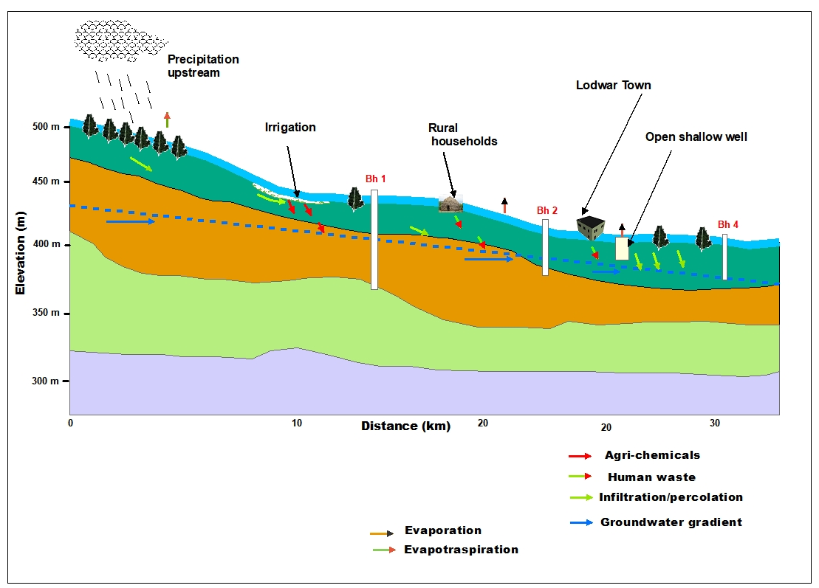
INITIAL SITE CONCEPTUAL MODEL
Rainfall is experienced upstream where infiltration occurs on laggas and along the Turkwel River
Boreholes upstream are dug to greater depths
Irrigation, sewerage and open-defecation result in possible contamination and pollution
Groundwater gradient follows the topography down to Lodwar

Slide 16
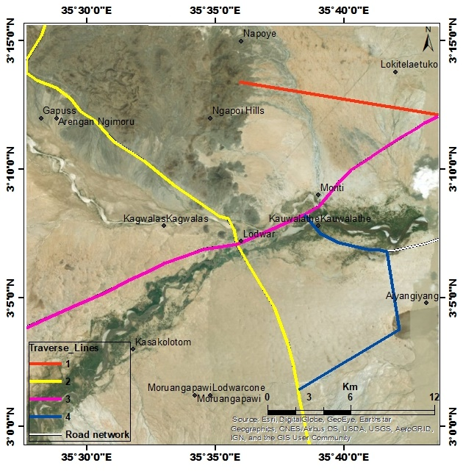
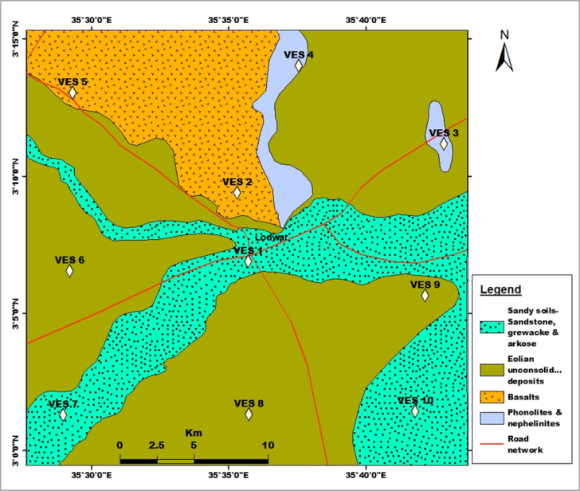
PLANNED ACTIVITIES: GEOLOGICAL
MAPPING AND ELECTRICAL RESISTIVITY
Investigation of geology and structural features in the area
Initially 10 vertical electrical resistivity soundings will be carried out to determine the type and depth of the geologic formations as well as aquifer layers.
Distribution of VES points is based on area geology.

Slide 17
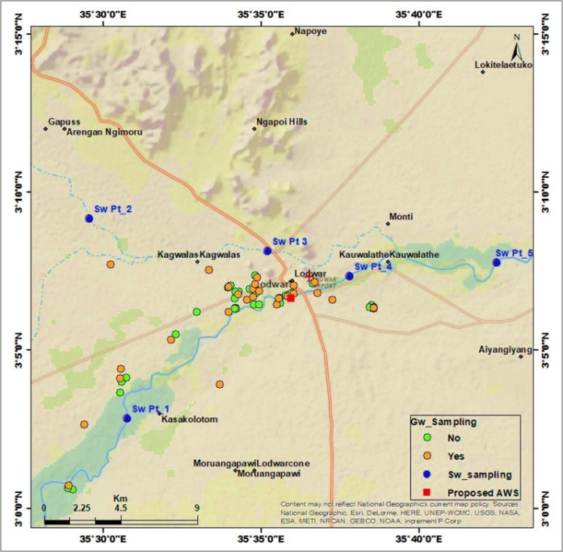
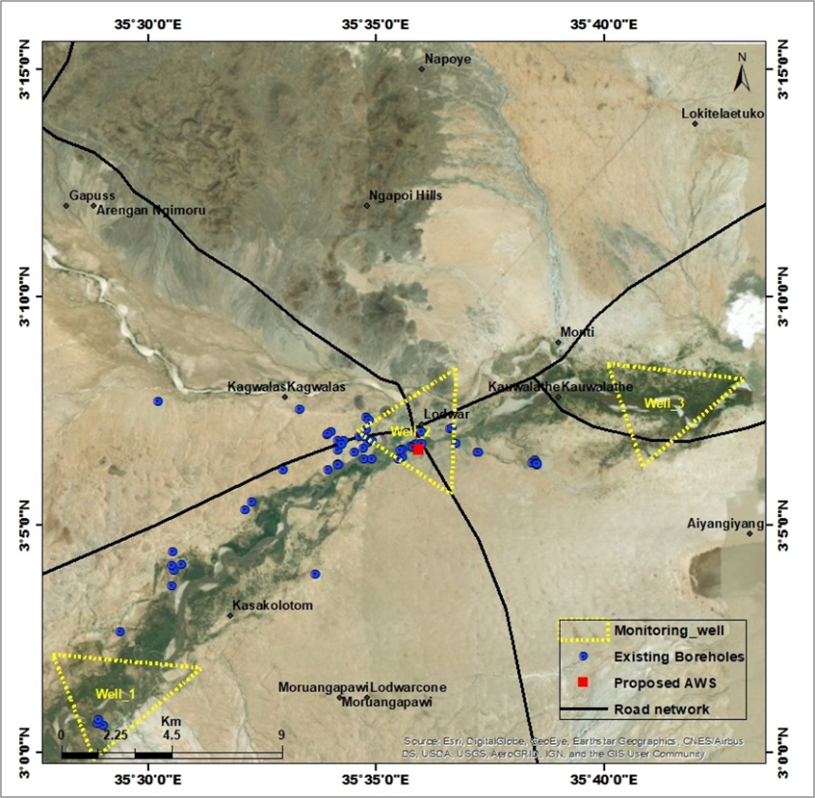
PLANNED ACTIVITIES: WATER
SAMPLES & MONITORING
Collection of groundwater, surface water and rainfall water samples for quality assessment and isotopic analysis
Involves monitoring of groundwater table and rainfall events in the area (groundwater and rainfall monitoring stations to be established)

Slide 18

Funded by:

