Slide 1

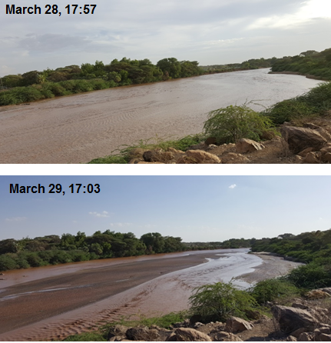
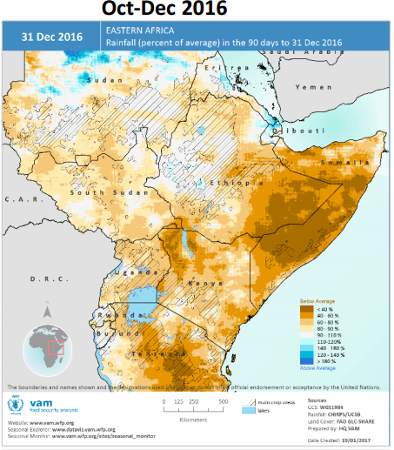
HYDRO-CLIMATIC RISKS TO
Feyera Hirpa, Ellen Dyer, Simon Dadson, Richard Washington & Rob Hope - University Of Oxford
THE TURKWEL RIVER BASIN
Climate Resilience, Water Services and Poverty in Kenya Turkana Stakeholder Workshop
Thursday 15 February, 2018

Slide 2
OUTLINE
Context: Turkana and Turkwel river basin
Climate variability and risk from a climate perspective
Decision scaling: risk from a hydrological and water allocation perspective
Moving forward: the long rains - how can we better understand future projections and risk?

Slide 3
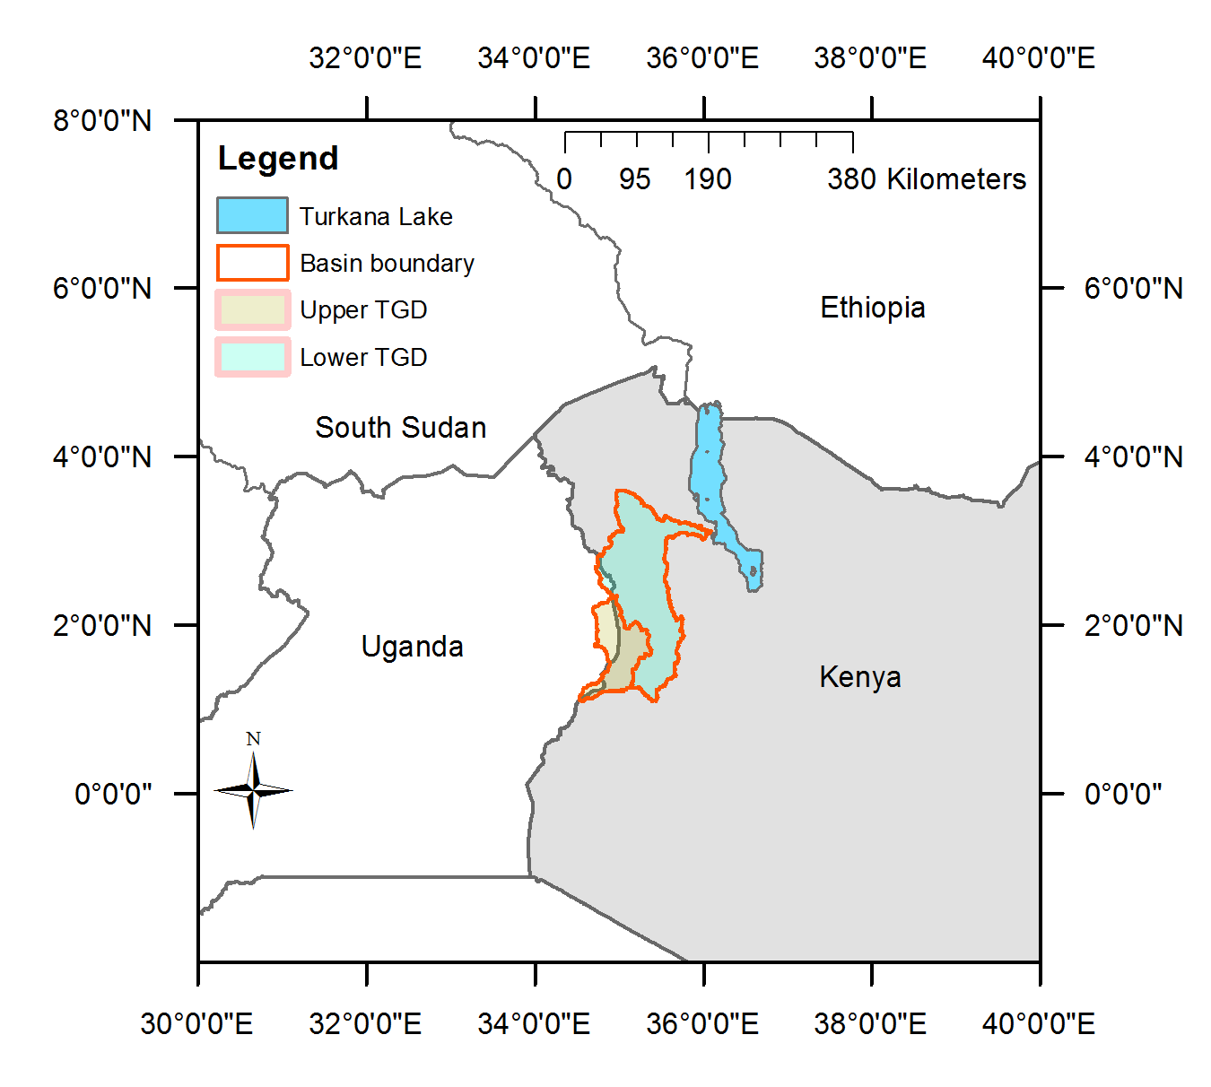
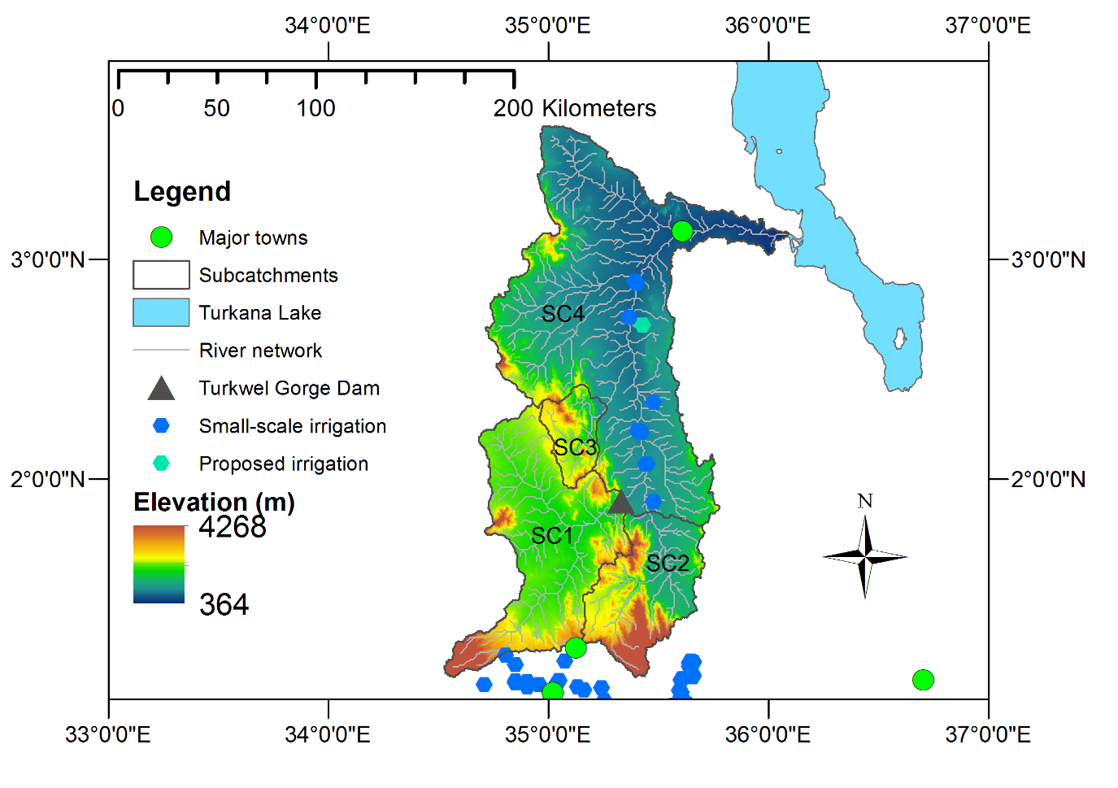
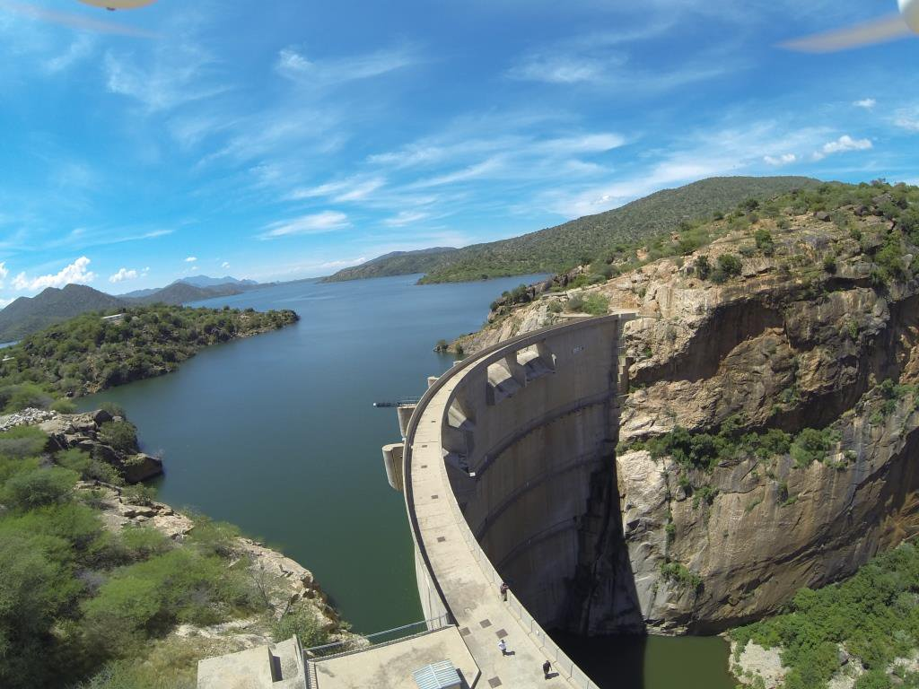
Turkwel River Basin covers 23,740 km² from Uganda through West Pokot to Turkana
One of the three rivers flowing into Lake Turkana
Critical resources for livestock, HEP, agriculture, industry and municipal supply

Slide 4
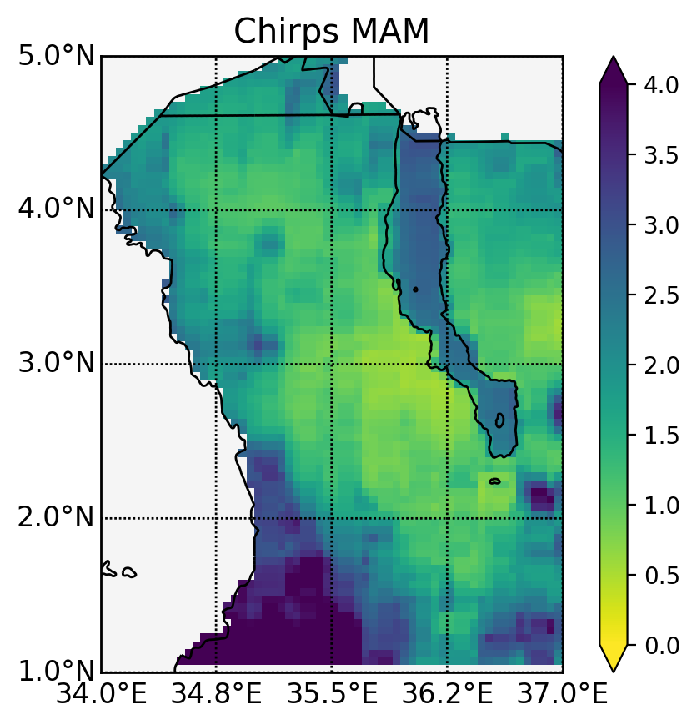
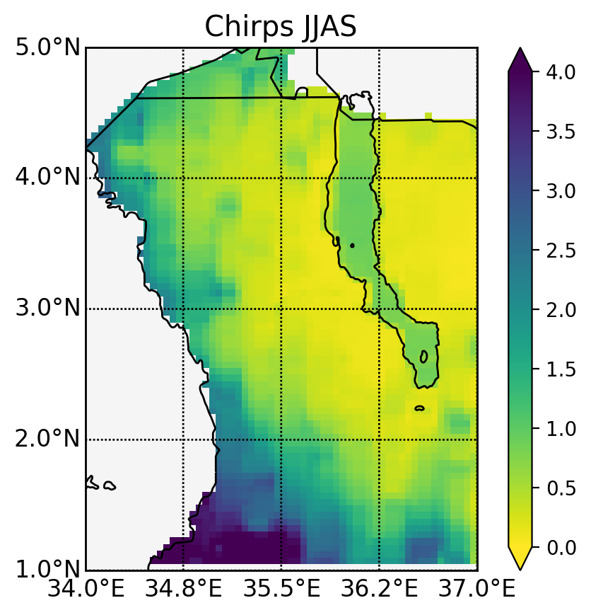
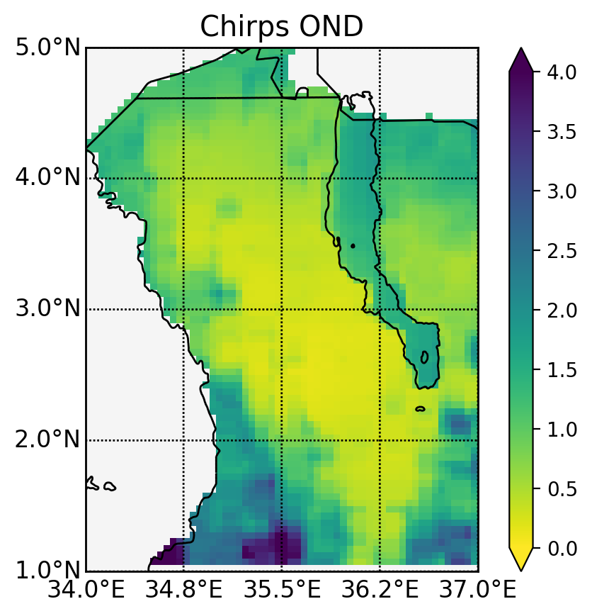
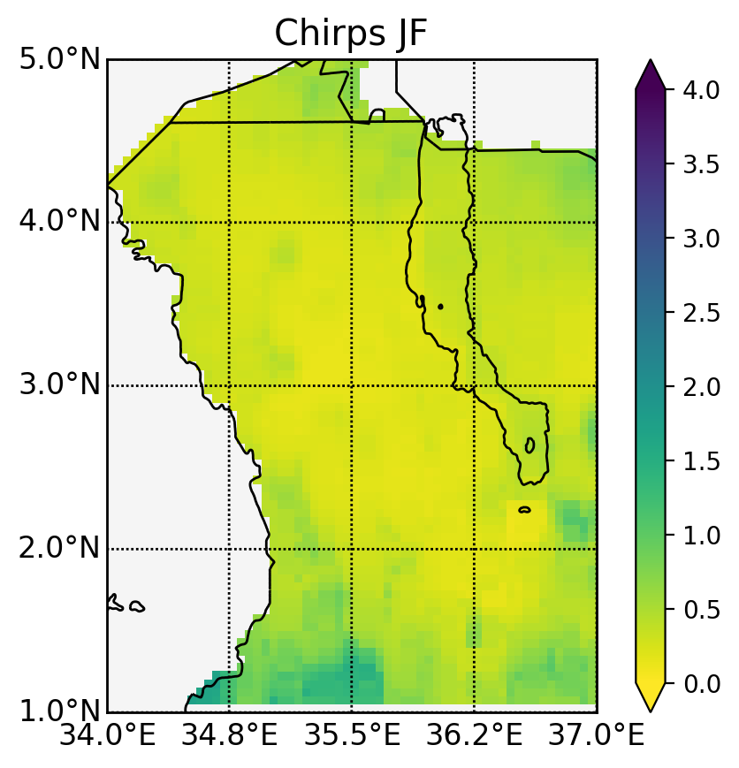
BASELINE
Data: CHIRPS v2.0
1981-2016
(mm/day)
MAM (long rains) has the highest rain rates of all seasons
Unlike other parts of Kenya, the rainfall climatology is not bimodal but peaks in MAM and decreases throughout the year
Some areas of Turkana and the Turkwel river basin have near zero rain rates for most of the year outside of MAM

Slide 5
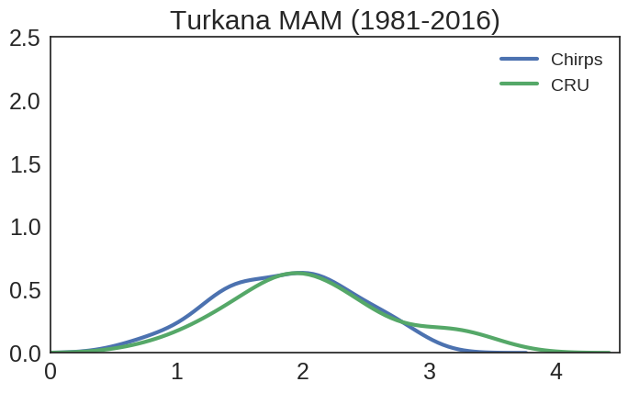
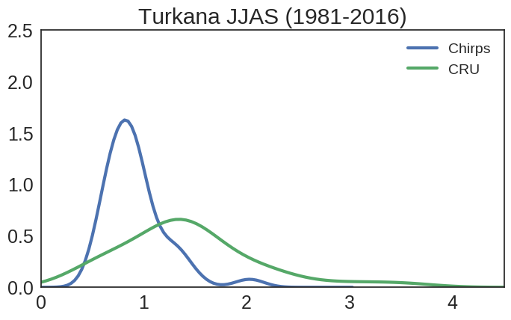
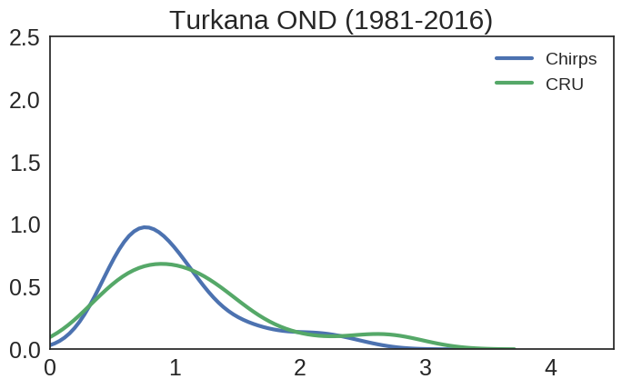
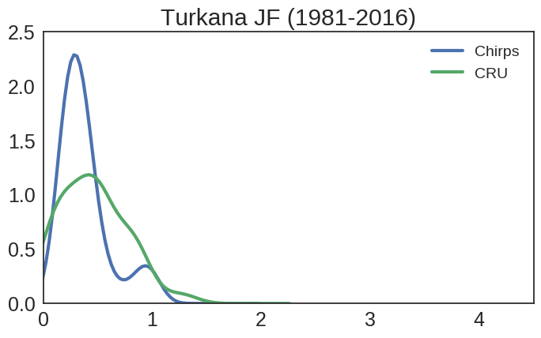
VARIABILITY
MAM has higher rain rates (the mean is just below 2mm/day) but the distribution of rain rates can reach up to 4 mm/day
The spread in JJAS is large for CRU but not for CHIRPS
  Gauge data sparsity is an issue, CHIRPS is merged satellite-gauge product
Agreement is better in OND and the rain rates are about half of MAM
Low rain rates of 1 mm/day are common outside of the long rains season
The range of extreme values is shown here but this does not show how these events are organised

Slide 6
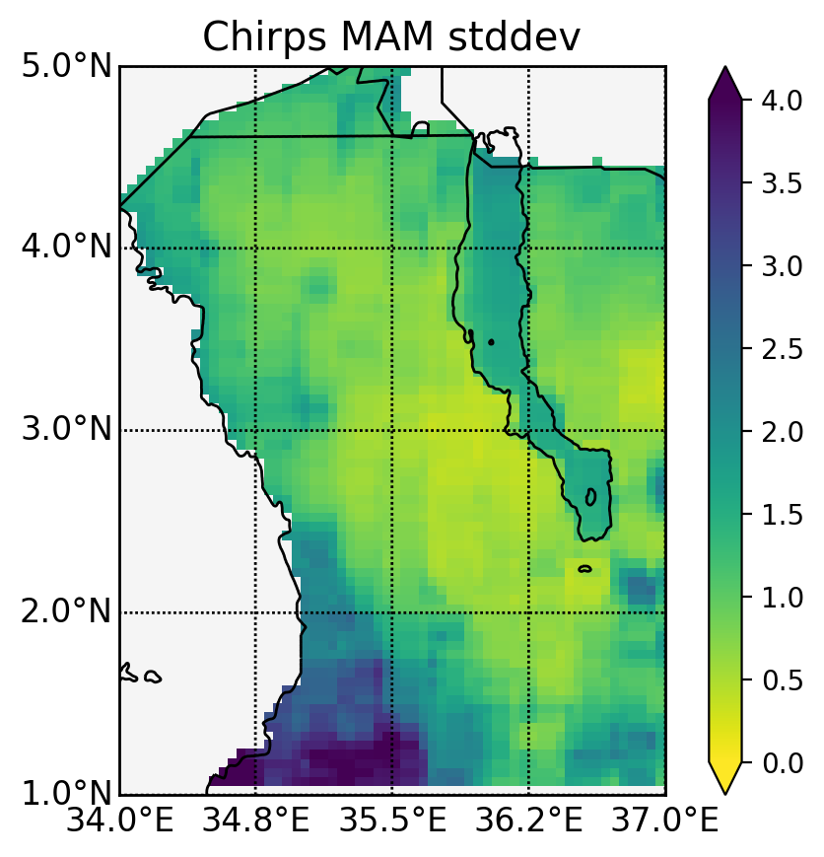
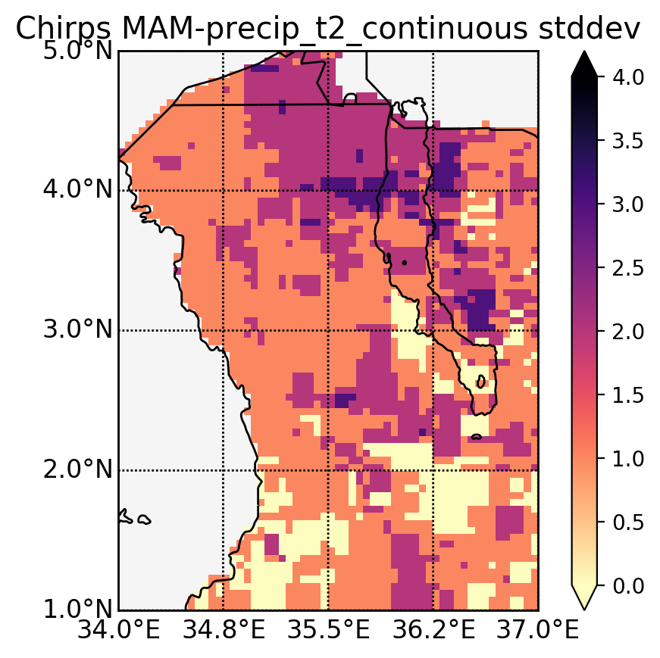
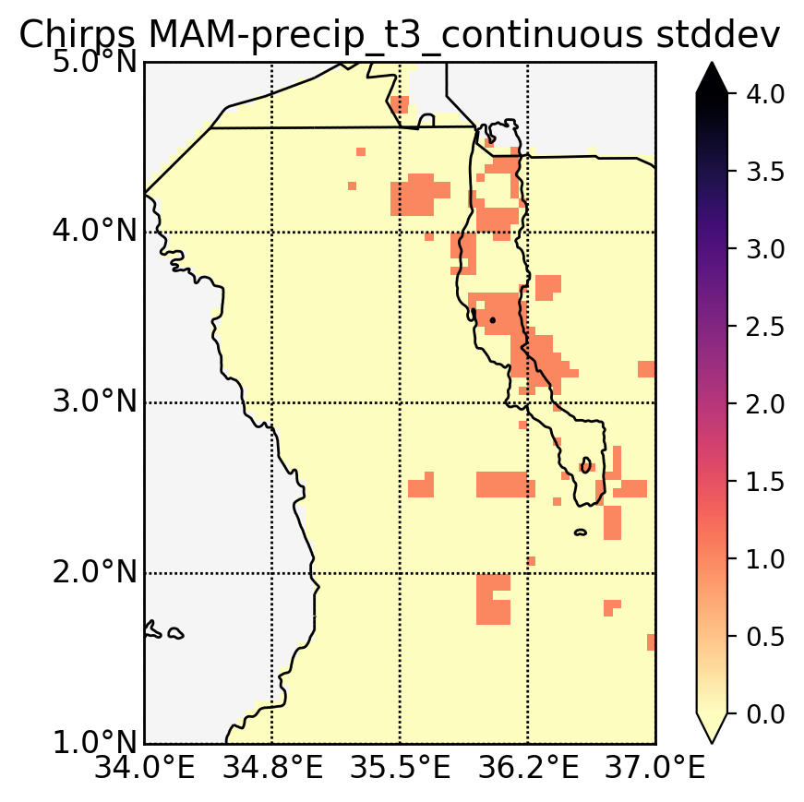
CONSECUTIVE EVENTS
MAM threshold (mm/day)
Two consecutive low MAM (count)
Three consecutive low MAM (count)
Data: CHIRPS v2.0
How often do dry events occur consecutively? And what is the impact of these events?
Example: setting a threshold of one standard deviation below the mean as a threshold, how often do two MAM seasons dip below this threshold one after the other, or three times in a row within 1981-2016?
Are these successive, but not individually extreme events as, if not more, detrimental than contained extreme events?

Slide 7
RESEARCH QUESTIONS
Climate change and variability
How do climate change and variability impact water scarcity in the basin?
How much of the water demand is currently met? And how does future expansion affect the water demand satisfaction?
What can be done to meet the rapidly growing water demand (efficient allocation and risk mitigation)?
Demand growth and risk exposure
Risk:
water scarcity
Risk mitigation
Efficient water use & allocation

Slide 8
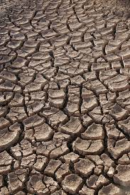
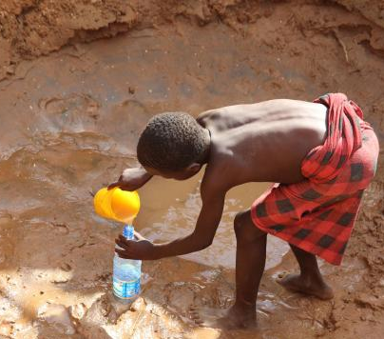
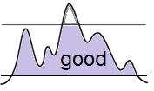
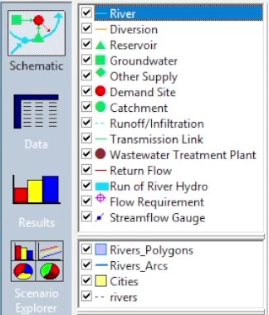
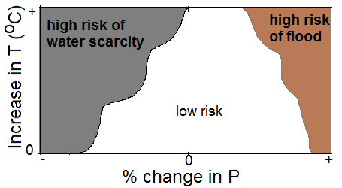
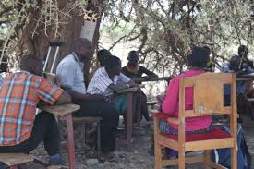
METHODOLOGY: RISK SCALING
Identify water-related risk in the basin
Define desirable threshold levels
Identify climate and demand conditions that may lead to the identified risk
Inform decisions around risk mitigation
e.g., drought-driven water scarcity, food shortage, and demand growth
e.g., minimum water requirement, maximum groundwater abstraction
e.g., improved agricultural practices,
water storage, reducing water loss
Adapted from Decision Scaling (Brown et al., 2012)

Slide 9
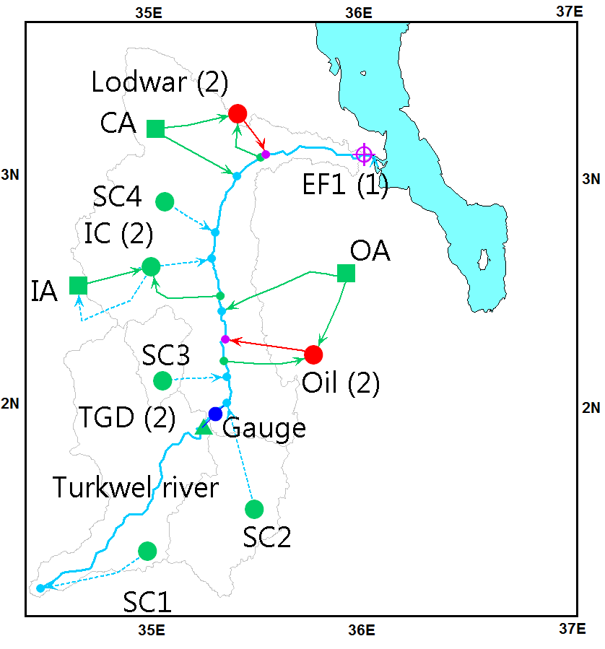
ANALYSIS: WEAP MODEL
Components:
Four sub-catchments (SC)
Irrigation catchment (IC)
Reservoir: Turkwel Gorge Dam (TGD)
Two demand sites: Lodwar town and industry
Three alluvial aquifers: CA, IA and OA
Environmental flow requirement (EF1)
WEAP is available at http://www.weap21.org/

Slide 10
WATER DEMAND SCENARIOS
Demand type | Scenario | Description | Informed by
Irrigated agriculture | A1 | 18 km² of irrigated cropland | FAO 2013 estimate [Maina et al., 2013]
 | A2 | 100 km² of irrigated cropland | FAO potential estimate [Maina et al., 2013]
 | A3 | 250 km² of irrigated cropland | Planned Turkwel Multipurpose Project [KVDA, 2013]
Lodwar town domestic consumption | P1 | Growth rate of 2.7% | Kenyan national average [KNBS, 2012].
 | P2 | Growth rate of 6.0% | Turkana County’s growth rate [Kenya County Fact Sheets, 2013]

Slide 11
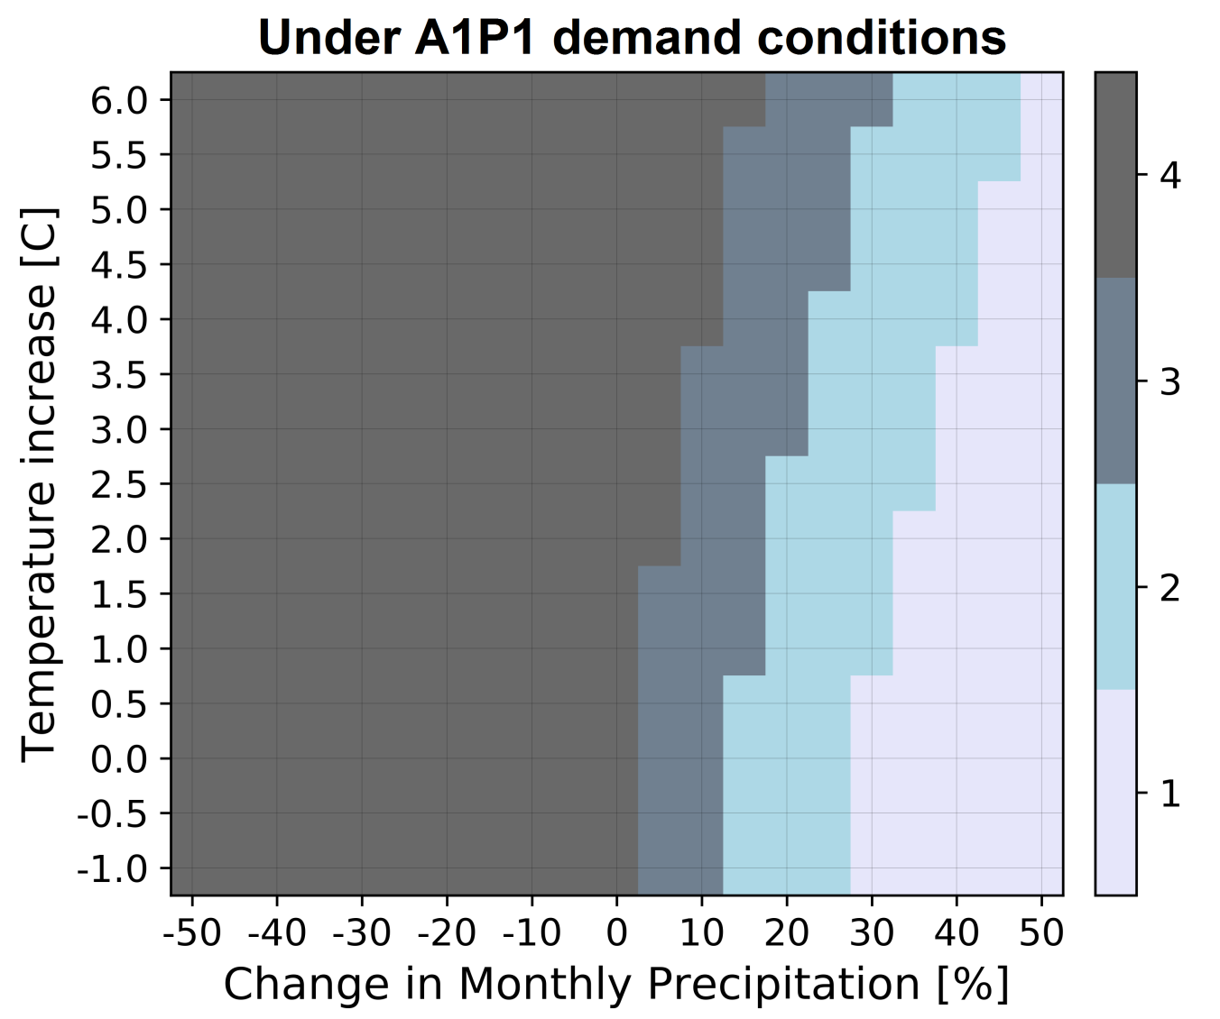
CLIMATE RESPONSE SURFACE
The impact of change in rainfall and temperature on meeting water demand and groundwater depletion
Total water Demand | Groundwater depletion
Unmet | Severe
Met in growing season | High
Met in growing season | Medium
Fully Met | Low
(changes relative to 1984-2013 data)

Slide 12
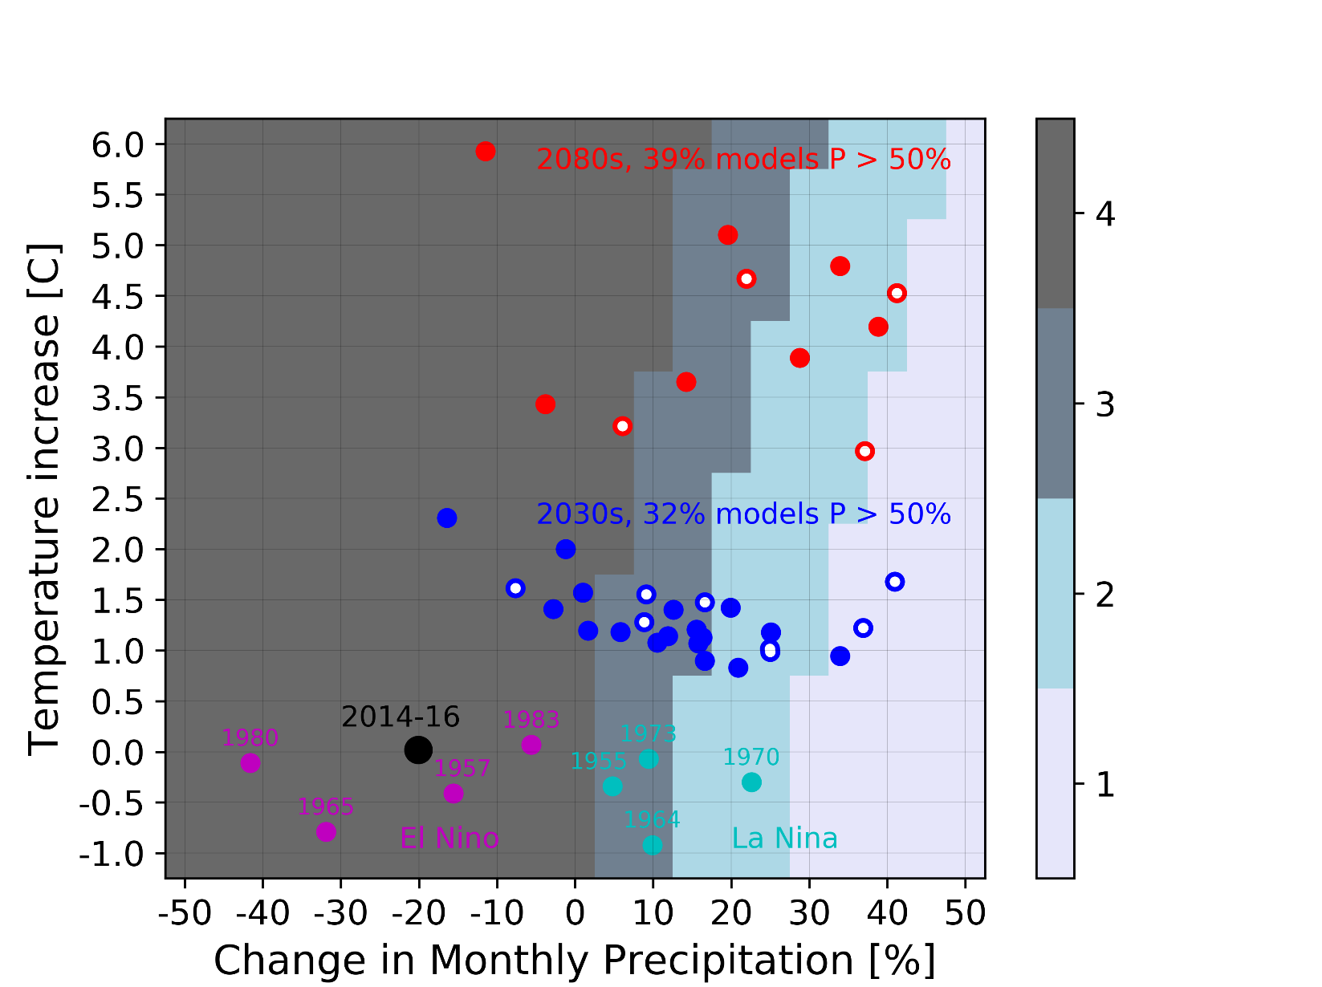
IMPACT OF CLIMATE CHANGE & VARIABILITY
GCMs
16% in 2030s
16% in 2080s
30% in 2030s
17% in 2080s
11% in 2030s
28% in 2080s
43% in 2030s
39% in 2080s
Historical data:
El Nino (1980, 1965, 1957 and 1993)
La Nina (1970, 1964, 1973 and 1955)

Slide 13
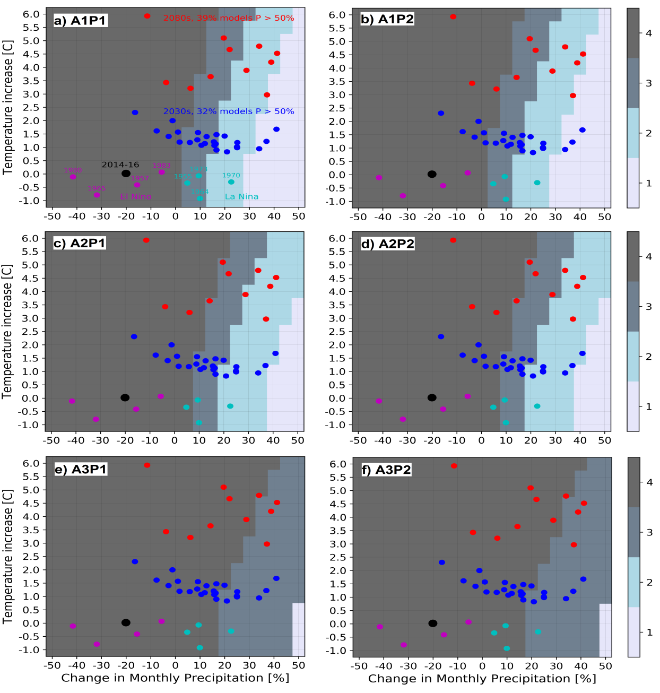
IMPACT OF AGRICULTURAL
AND POPULATION GROWTH
Increasing irrigation puts additional stress on the water resources.
Significant rainfall increase is needed to maintain low risk level

Slide 14
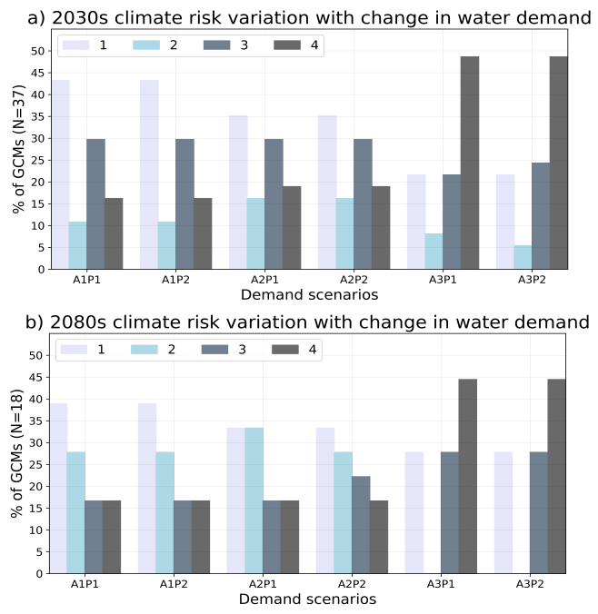
IMPACT OF AGRICULTURAL
AND POPULATION GROWTH
Increasing irrigation puts additional stress on the water resources
The severe risk (“category 4”) of future climate increases 3 times from A1P1 (16%) to A3P2 (48%)

Slide 15
IMPACT OF AGRICULTURAL
AND POPULATION GROWTH
  Results reveal that:
  The basin has been historically water-stressed
  Expanding irrigation and climate variability are the main drivers of water scarcity in the basin
  A potential increase in crop irrigation from 18 km² to 250 km² significantly increases the risk due to future climate change
  Decision scaling has shown that even though the ensemble of climate models shows more rain in the future that some development scenarios may still present risks

Slide 16
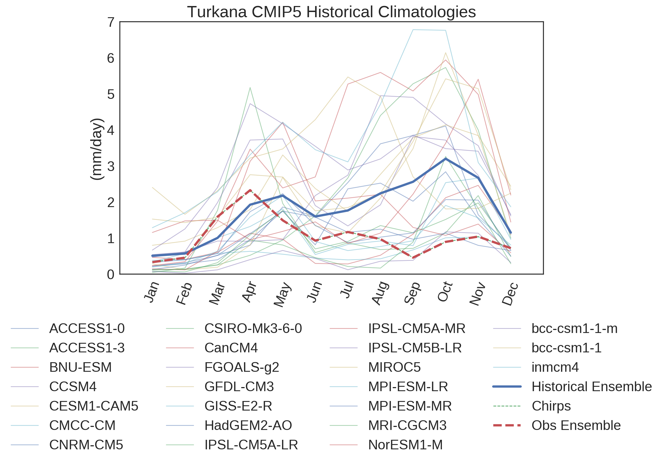
Very few models are able to reproduce rainfall in Turkana, missing the climatology and showing increasing rather than decreasing long rain trends in the historical period
This leads to low confidence in the predicted trends
Challenge: understand why coupled models cannot capture long rains, and better constrain future projections

Slide 17
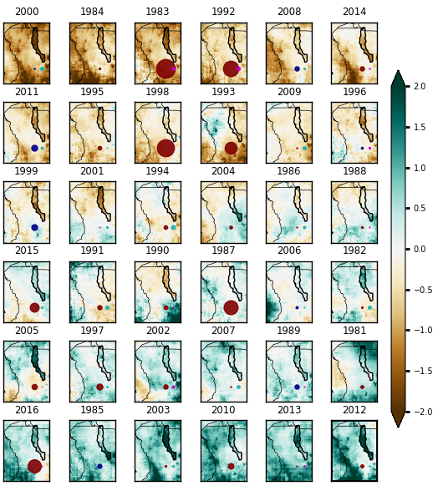
CLIMATE EXTREMES & TURKANA
MAM anomalies (mm/day)
Long rain anomalies have been ordered from driest to wettest years
ENSO and Indian Ocean dipole (IOD) indices have been overlaid
Applying these indices in MAM is not as helpful in diagnosing wet and dry years as it is in OND
Understanding MAM variability is not as straightforward as OND variability, but this season is the most important source of rainfall for Turkana
Red is El Nino
Green is + IOD
Blue is La Nina
Purple is - IOD

Slide 18
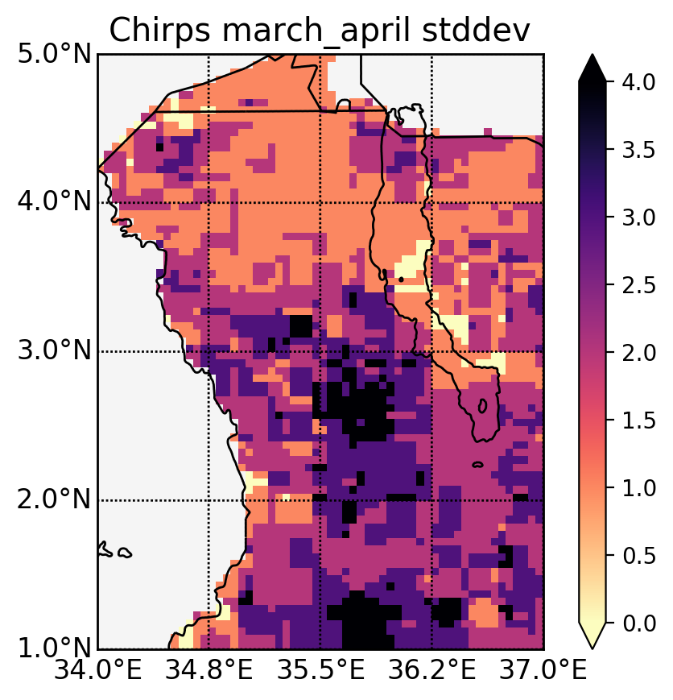
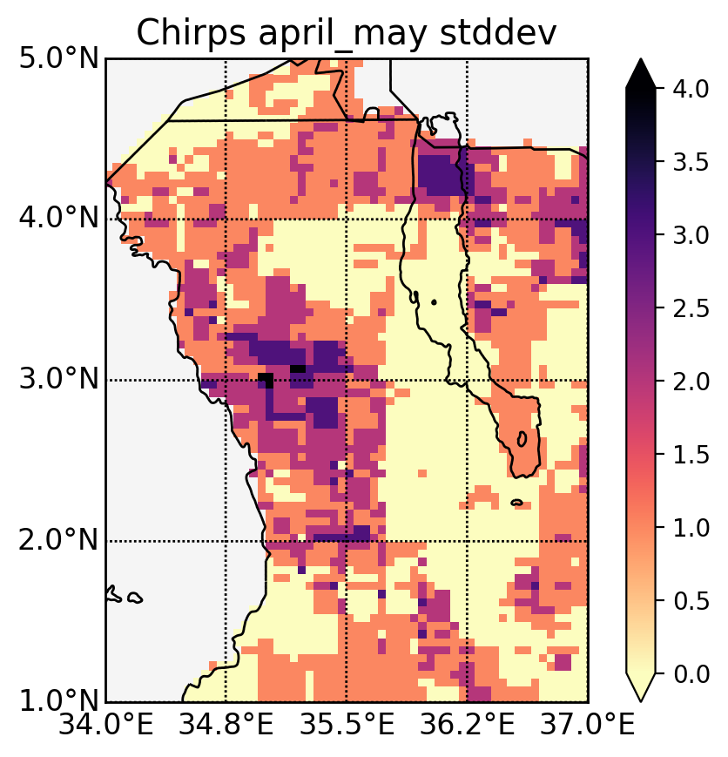
UNDERSTANDING THE LONG RAINS: BREAKING UP THE SEASONS
Low March - Low April
Low April - Low May
Data: CHIRPS v2.0
What does a short long rains season look like?
  How often is a dry March followed by a dry April vs a dry April followed by a dry May
Long rains are predominantly short because they start late
  What large scale climate drivers cause this?
  Understanding subseasonal variability will lead to a better characterisation of rainfall and a better understanding of what climate drivers affect rainfall in Turkana

Slide 19
SUMMARY
Risk mitigation may consider demand (irrigation, environmental flow regulations) and supply responses (new water resources)
Without investing in improved hydro-climatic monitoring policy choices will continue to face significant scientific uncertainty
Lodwar’s future expansion and growth will depend on a robust and effective water resource management strategy
Existing challenges include limited in situ data and large uncertainty in the future hydro-climatic trajectories (the “East African climate paradox”)
Currently trying to understand drivers of long rain variability by looking at the sub-seasonal scale and applying these findings to available global climate models

Slide 20

Funded by:

