Slide 1
Water justice: recognising different needs and practices
Thank you for joining the RWSN webinar today!
The webinar will start in a few minutes…

Slide 2
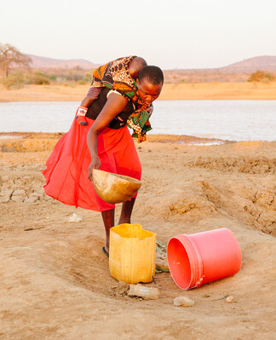


Leave no one behind in rural water supply
Webinar Series 2019
Understanding & implementing Leave no one behind
Self-supply: How to reach all
Water justice: needs and practices
Water quality testing
Borehole drilling by private enterprises
Planning & Financing for Universal Access
Communicating with farmers on climate risks
Photo: Simavi 2018
Webinar Sponsors:
With thanks to:
IRC
Simavi
Skat
UNICEF
UNC Water Institute
WaterAid
World Bank
…and all speakers and Chairs
Register at https://www.rural-water-supply.net/en/
Series Sponsor
Notes:
English
Good morning, good afternoon and good evening. Welcome to our Webinar series 2019 on Leave no one behind in Rural Water Supply. Thanks for joining us and we hope that you will enjoy today’s webinar.
My name is (name), I am from (organisation)
I will be chairing today’s webinar which is on (name of webinar)
This webinar has been organised by the RWSN secretariat and the REACH programme, which is a global research programme to improve water security for the poor by delivering world-class science that transforms policy and practice. I would like to thank everyone who has helped with organising this webinar and the REACH research program whose financial support to the RWSN Secretariat has made this webinar possible and free to participants.
Now, before we start with the presentations, I would like to make sure you all are able to solve any technical problems that you may have.

Slide 3
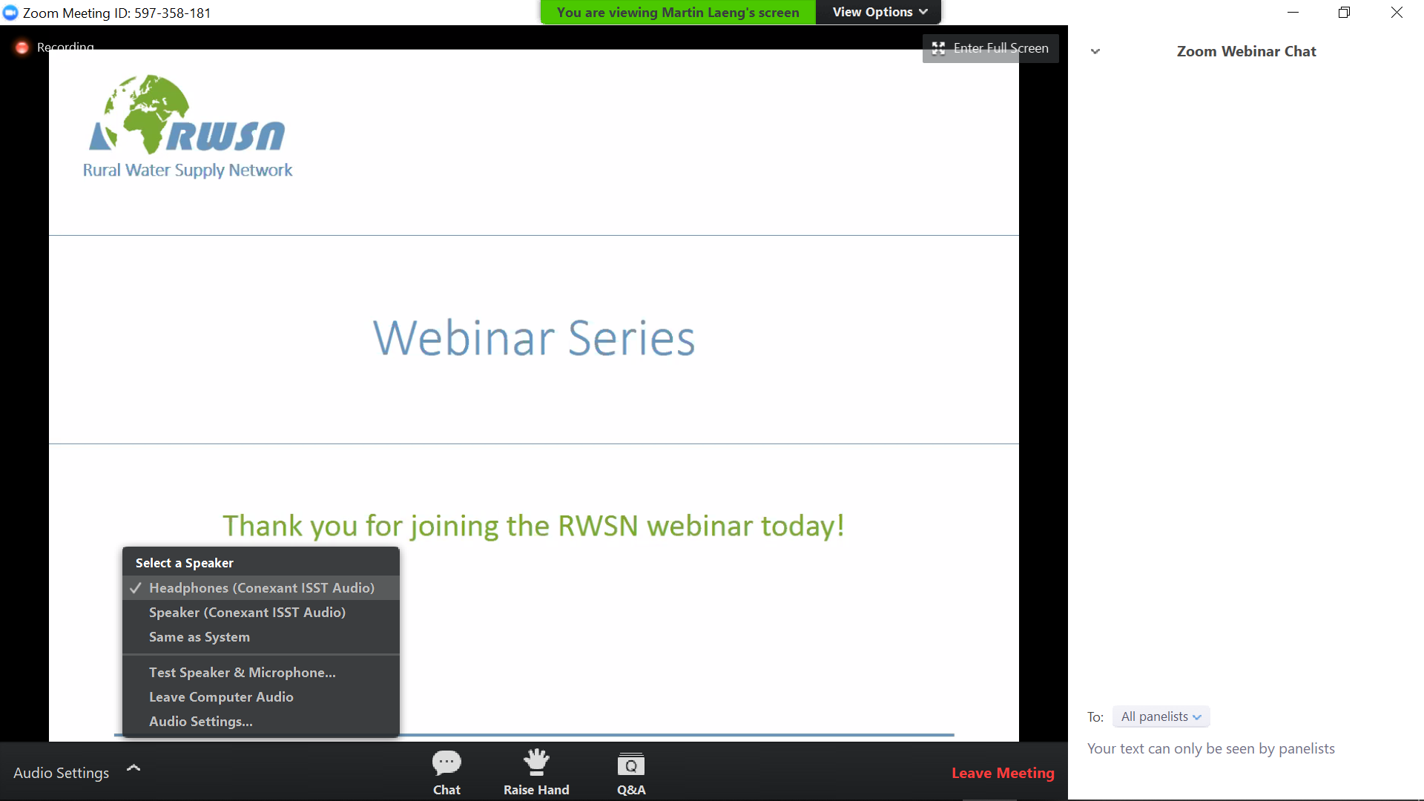
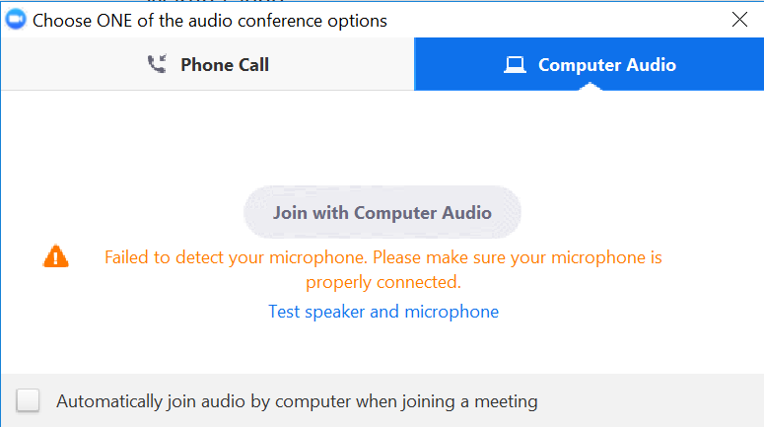
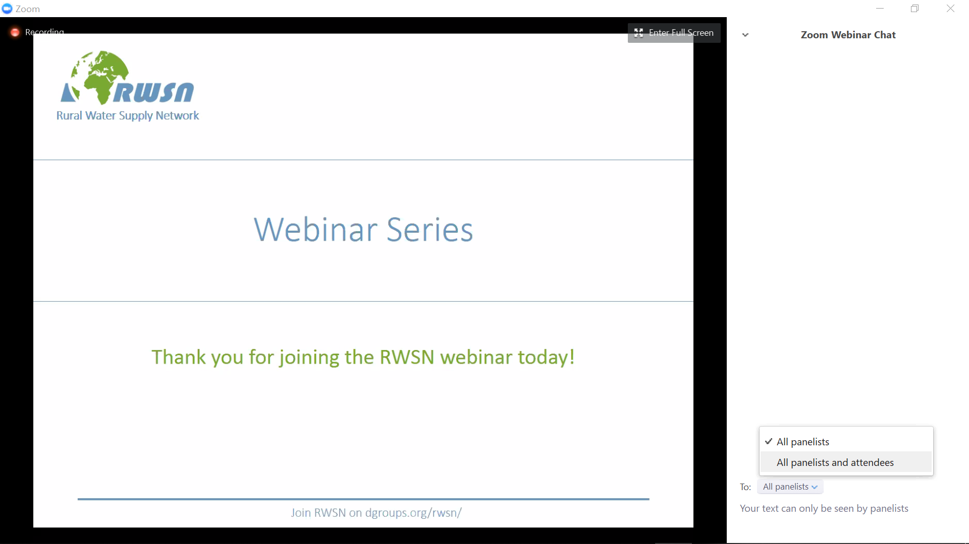
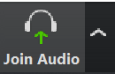
Connect your audio device
Join with Computer Audio and select different speakers
Join with Computer Audio and select a different speakers
Write your questions here
If you still have problems hearing, please contact Martin Laeng
(martin.laeng@skat.ch) and he will help you
Notes:
This slide is for everyone who may have any problems hearing us through the Zoom software. It shows how to use the audio settings. If you still have technical problems, please contact Martin Laeng and he will help you.
If this is your first webinar, I would like to point out that on the bottom right of the screen you can see the “chat box”. It is in the bottom right of the screen. This is the place that you can use to send written messages. Just above the message box you can select who the message is sent to. You shall be using this chat box to write in your questions and comments throughout the webinar. In your message you can write the name of person you want to address your question to.
Now, just to get an overview who is attending and be sure that you know how to use the system, please could you type in the chat box your organisation and the country where you are at the moment. Make sure that you send the message to everybody.

Slide 4
Webinar Series:
“Leave no one behind” in rural water supply
 | Webinars start in English @ 14.30 CET | 2nd Language Français @ 11.00 CET Español @ 16.30 CET
16 Apr | “Leave no one behind” - What does it mean for rural water supply? | Français
23 Apr | How to reach all: practical examples of supported Self-supply. | Español
30 Apr | Water justice: recognising different needs and practices | Français
07 May | Including water quality testing into routine monitoring | Español
14 May | A conversation about borehole drilling by private enterprises | Français
21 May | Planning and Financing for Universal Access | Français
28 May | Communicating groundwater-climate behaviour with African farmers | Français
4 Jun | Hands-on! How do we implement “Leave no one behind” in rural water supply? | Français
Register at https://www.rural-water-supply.net/en/
To view past webinar recordings https://vimeo.com/channels/rwsnwebinars
Notes:
You may be aware that today’s webinar is one of a 8 part series that runs up to beginning of June 2019. All webinars start at 14.30 CET in English and will be presented on the same day in a second language, either in French or in Spanish, but at a different time.
If you would like to take part in one of our webinars in French or in Spanish, please follow the link on the slide to register. You will then receive by email the instructions to connect to the next webinar.
The webinar series cover many different topics, all related to leave no one behind in rural water supply. Each webinar has a particular focus, for example….
Advice: ask the chatbox moderator to post all links in the chatbox, so participants can easily copy them:
Register at https://www.rural-water-supply.net/en/collaborations/details/105
or at https://zoom.us/webinar/register/WN_fdI-9RUSRciYum2COSP6Kw
To view past webinar recordings https://vimeo.com/channels/rwsnwebinars

Slide 5
Water justice: recognising different needs and practices
Notes:
This was the technical check, let us begin. Today´s webinar is on Water justice: recognising different needs and practices. Special thanks to the REACH research programme, which is a global research programme to improve water security for the poor by delivering world-class science that transforms policy and practice.
Pitch for the audience: What will you learn today?
Key points with main topic or questions:

Slide 6

Leave no one behind
Notes:
Feel free to insert a photo, framework, quote or any other idea that you have to show how this webinar topic links to Leave no one behind. You can remove the LNOB icon. If you prefer to show this slide later, for example in the Question and Answer Session or after the Agenda, you can move it around. If you need advice, you can discuss with Louisa, Sara and Priya (contacts below). If you or one of your speakers will explain it later anyhow, you might rename or remove the slide.
Pitch for the audience: How does this topic is related to Leave no one behind?
Key points:
Leave no one behind community leaders:
Louisa Gosling - LouisaGosling@wateraid.org
Priya Nath - PriyaNath@wateraid.org
Sara Ahrari - Sara.Ahrari@simavi.nl

Slide 7
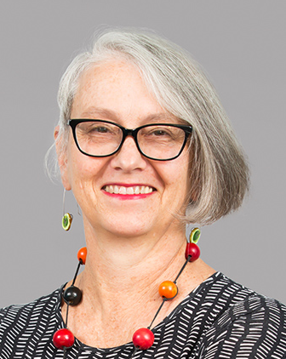
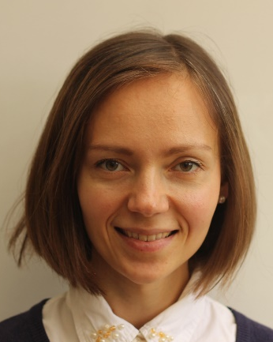
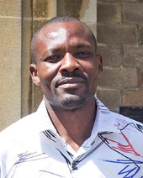
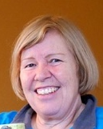
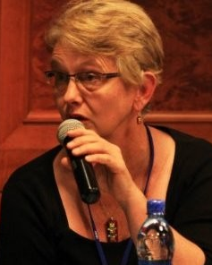
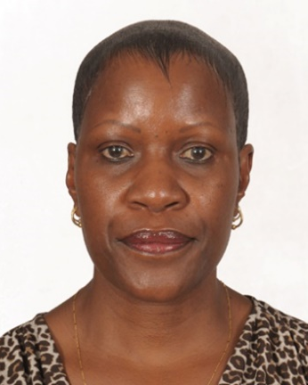
Who is who
Presenters
Dr Marina Korzenevica-Proud
University of Oxford
Dr Dalmas Omia
Universiy of Nairobi
Dr Barbara van Koppen
International Water Management Institute
Barbara Schreiner
Water Integrity Network
Facilitator
Webinar Management
Alice Chautard, University of Oxford
RWSN secretariat/ Skat Foundation
Dr. Maggie Opondo
University of Nairobi
Notes:
Introduce the people who have helped put together this webinar today:
Presenters, discussants, facilitator (Present them in maximum of 1-2 sentences each)
Dr. Maggie Opondo
---
Dr Marina Korzenevica-Proud
Postdoctoral Researcher, School of Geography and the Environment, University of Oxford
marina.korzenevica@smithschool.ox.ac.uk
Dr Marina Korzenevica-Proud is managing the “Exploring Inequalities Grant” by co-developing a research study in partnership with teams from Bangladesh, Ethiopia and Kenya. These studies are based on qualitative methods and are focused on the exploration of water related vulnerabilities, particularly along the gender and disability lines. Prior to this position, Marina completed her PhD degree within the Environment and Society in Developing Countries group at the University Copenhagen, Denmark. Using long-term ethnographic methods she has been exploring the socio-political implications of a mobility and education boom in rural Nepal, specifically focusing on how young people (men and women) negotiate their life chances and are agents of socio-political change. Analysis of gender roles, household dynamics and every day politics has been interweaving every aspect of her research. Before her PhD, Marina completed an MSc in Development Studies with a focus on water and climate change.
DR. DALMAS OMIA
UNIVERSITY OF NAIROBI, <dalmas.ochieng@gmail.com>
Dalmas Omia is a social anthropologist based at the University of Nairobi Kenya and a researcher in REACH's Kitui observatory on improving water security for the poor
¨
Dr Barbara van Koppen
Principal Researcher Poverty, Gender, and Water, International Water Management Institute
B.VanKoppen@cgiar.org
Barbara van Koppen (PhD) is Principal Researcher Poverty, Gender, and Water at the International Water Management Institute (IWMI). She leads comparative (action-) research in Africa and Asia on plural water laws, human rights, policy reform, and community-led water service delivery for multiple uses (MUS). She is lead-author and -editor of five books and (co-) author of over 130 international peer-reviewed publications. In addition to leading and participating in global and national policy dialogues, she served in the Steering Committee of the Global Water Partnership and the Board of the Water Research Commission South Africa. The global Multiple Use water Services (MUS) Group is coordinated by her. Before joining IWMI she was lecturer gender and irrigation at Wageningen University and Research Center, The Netherlands, where she also obtained her Ph.D., and technical assistant in Burkina Faso.
Barbara Schreiner
Barbara Schreiner took up the position of Executive Director of WIN in January 2019. She has over 20 years’ experience in water and natural resources management in developing countries with a focus on good governance and addressing poverty and inequality, including gender and other forms of social and economic marginalisation. Before joining WIN, she was the first Executive Director of the Pegasys Institute, a not-for-profit organisation working to find African solutions to African challenges in the fields of water and infrastructure. She was also a Director at Pegasys Consulting. Prior to this she worked for over a decade in senior management in the public water sector in South Africa including as Ministerial advisor. She has been and is active on a number of Boards, including as a member of the Board of the International Water Management Institute (IWMI) for many years, the International Steering Committee of the Global Water Partnership, Deputy Chairperson of the Isimangaliso Wetland Park World Heritage Site (current), and previous Chairperson of the Water Research Commission of South Africa. She has written extensively on issues of water governance, poverty and gender.
Whole team working in the background to make this webinar possible: The secretariat of RWSN, based at Skat Foundation in Switzerland and Alice Chautard, from the University of Oxford/ REACH programme.

Slide 8
Agenda
Welcome
Presentations
Water justice: recognizing different needs and practices
Gender Inequalities and Water Affordability in Kitui County
Towards a Hybrid Water Law to Overcome the Injustices of Current Permit Systems in Africa
Reflections by Facilitator
Questions & Answers
Closing
Notes:
English:
Today’s webinar has (1, 2 or 3 presentations) presentations. The overall duration is (60 or 90) mintues. We first will hear the presentations, and after the presentations there is going to be a question&answer session for the presenters (update structure). However, please do type your questions and comments with name of the presenter into the chat box as you think of them and we go to them after the presentation.
So let us get started without any further delay I will hand over to Dr Marina Korzenevica-Proud
…
Thank you for this excellent presentation. We will now hear from DR. DALMAS OMIA
3. Dr Barbara van Koppen (Q&A session: Barbara Schreiner)
Structure of your webinar:

Slide 9

Question time
All webinar presentations will be available on:
RWSN Website: http://www.rural-water-supply.net/en/resources/details/847
Youtube as RWSN Talks
Vimeo: https://vimeo.com/channels/rwsnwebinars
Notes:
English
Now we have time for comments and questions.
Please could you write your questions with the name of the presenter in the chat box below – our Chatbox Moderator will be selecting questions for me to ask the presenters.
After such interesting presentations I am looking forward to a good discussion
(need to have a few backup questions ready in case participants are hesitant to get started)
Advice: ask the chatbox moderator to post all links in the chatbox, so participants can easily copy them
RWSN Website: http://www.rural-water-supply.net/en/resources/details/847
Youtube as RWSN Talks: https://www.youtube.com/playlist?list=PL2ECKtJt6JB1zIjWFbBVcY7CKESNIvt0l
Vimeo: https://vimeo.com/channels/rwsnwebinars

Slide 10
Further reading and help
REACH – Improving water security for the poor:
https://reachwater.org.uk/
REACH contact:
Alice Chautard - alice.chautard@ouce.ox.ac.uk
Join the virtual community:
https://dgroups.org/rwsn/sustainable_services_rwsn
You missed a webinar or want to review it?
https://vimeo.com/channels/rwsnwebinars
Notes:
Please add the information on your theme/ programme
Advice: ask the chatbox moderator to post all links in the chatbox, so participants can easily copy it

Slide 11
Webinar Series:
“Leave no one behind” in rural water supply
 | Webinars start in English @ 14.30 CET | 2nd Language Français @ 11.00 CET Español @ 16.30 CET
16 Apr | “Leave no one behind” - What does it mean for rural water supply? | Français
23 Apr | How to reach all: practical examples of supported Self-supply. | Español
30 Apr | Water justice: recognising different needs and practices | Français
07 May | Including water quality testing into routine monitoring | Español
14 May | A conversation about borehole drilling by private enterprises | Français
21 May | Planning and Financing for Universal Access | Français
28 May | Communicating groundwater-climate behaviour with African farmers | Français
4 Jun | Hands-on! How do we implement “Leave no one behind” in rural water supply? | Français
Register at https://www.rural-water-supply.net/en/
To view past webinar recordings https://vimeo.com/channels/rwsnwebinars
Notes:
Finally a reminder the upcoming webinars. Next week, is from the Mapping and Monitoring Theme with speakers and discussants tackling the topic of Including water quality testing into routine monitoring
Order of webinar themes
16 Apr LNOB
23 Apr Self-supply
30 Apr REACH Program
7 May Mapping and Monitoring
14 May Sustainable Groundwater Development
21 May Sustainable Services
28 May UPGro Program
4 Jun LNOB

Slide 12
Leave no one behind in rural water supply
Webinar Series 2019
Understanding & implementing Leave no one behind
Self-supply: How to reach all
Water justice: needs and practices
Water quality testing
Borehole drilling by private enterprises
Planning & Financing for Universal Access
Communicating with farmers on climate risks
Photo: Simavi 2018
Webinar Sponsors:
With thanks to:
IRC
Simavi
Skat
UNICEF
UNC Water Institute
WaterAid
World Bank
…and all speakers and Chairs
Register at https://www.rural-water-supply.net/en/
Series Sponsor
Notes:
Thanks again to our speakers, (name of speakers).
Thank you to SDC for the financial support that has made this webinar series possible
And finally, thank you again for attending, and see you next time.

Slide 13
Thank you for joining the RWSN webinar today!

