Slide 1

Insert image here. Do not compress to fit the size. Instead, use the cropping tool (found under the format tab). Increase the size of the image proportionally until it fits the width of the slide, then crop to decrease the height.
Speaker institution logo

Slide 2
QR code Powerpoint template
Purpose – for REACH partner researchers to be able to create branded slides showcasing REACH outputs with a QR code + image included.
The example slides which follow were created using
  A screenshot of the front of the paper / report
  A weblink for the paper report starting https://reachwater.org.uk/resources/
  A QR code linking to the weblink created using a free website – options include:
    https://www.qrcode-monkey.com/

Slide 3

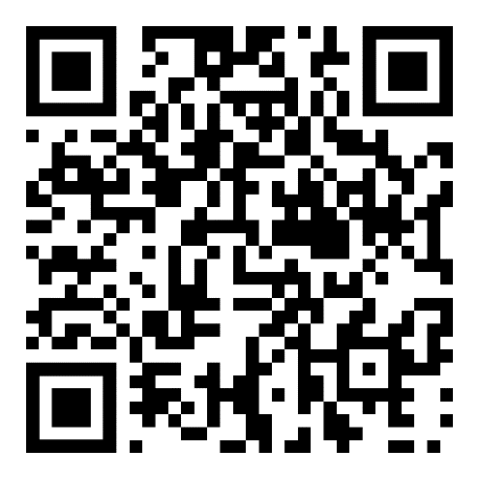
https://reachwater.org.uk/resource/climate-and-water-report/

Slide 4
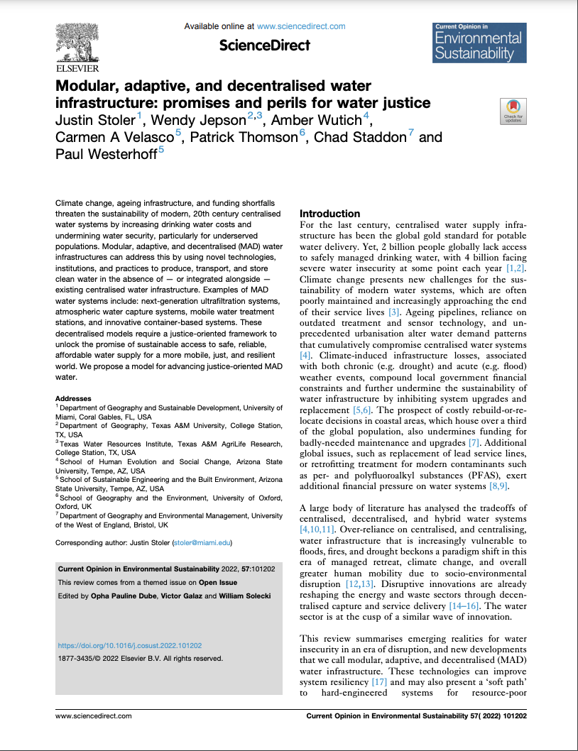
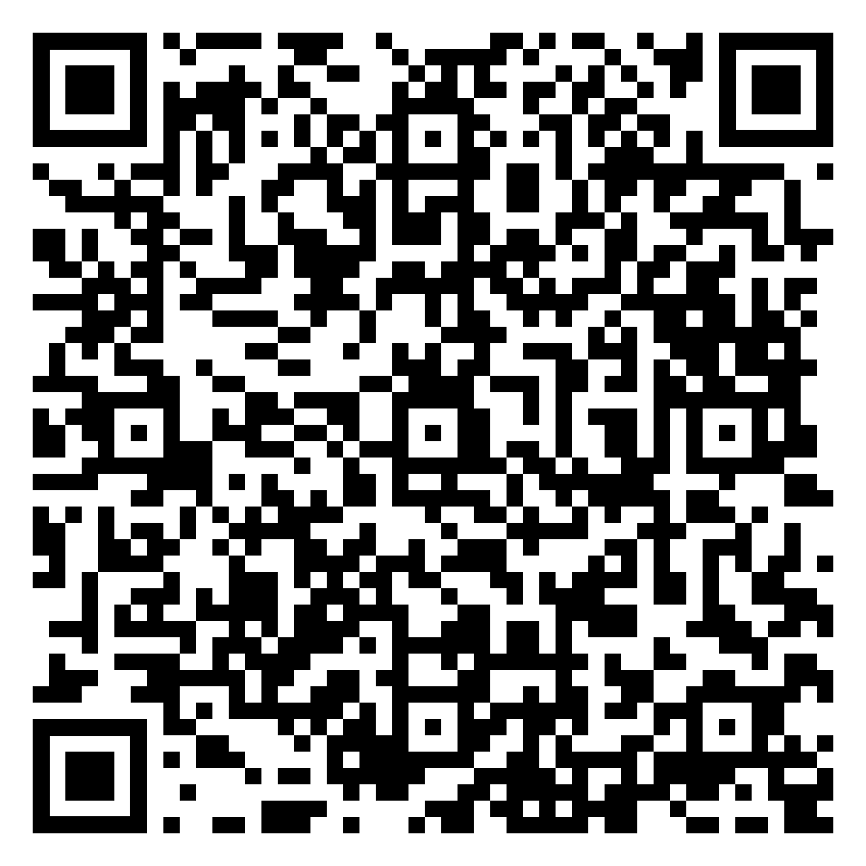
https://reachwater.org.uk/resource/modular-adaptive-and-decentralised-water-infrastructure-promises-and-perils-for-water-justice/

Slide 5

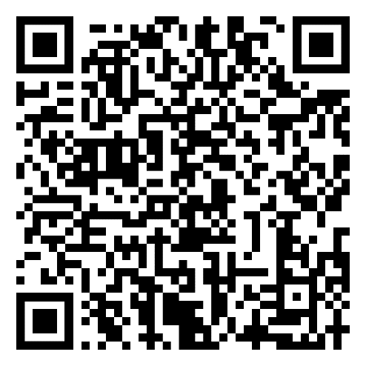
https://reachwater.org.uk/resource/addressing-socio-economic-inequalities-in-lodwar-and-broader-turkana/

Slide 6
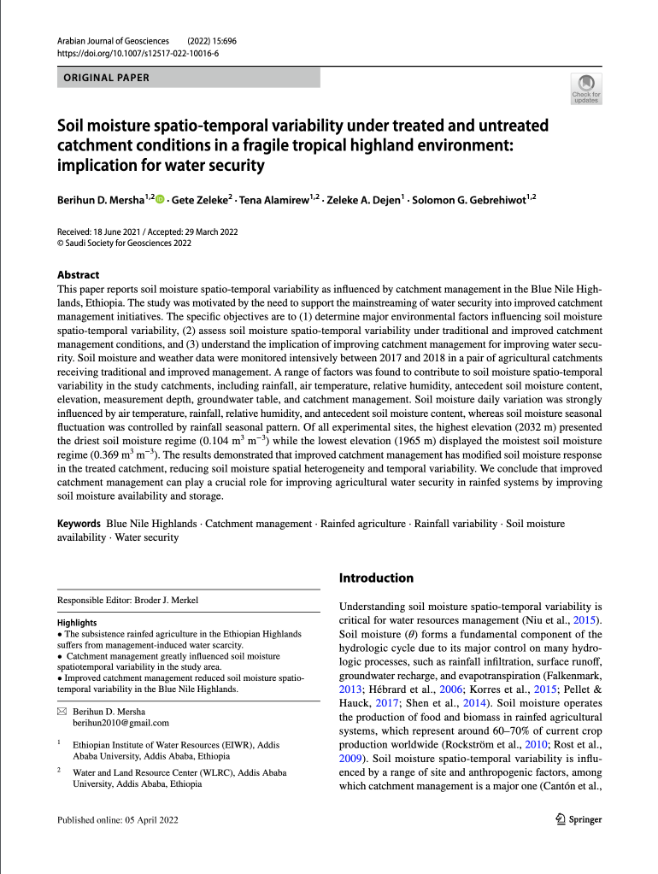
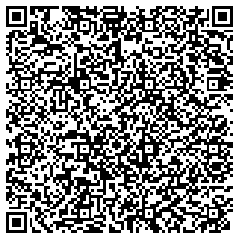
https://reachwater.org.uk/resource/soil-moisture-spatio-temporal-variability-under-treated-and-untreated-catchment-conditions-in-a-fragile-tropical-highland-environment-implication-for-water-security/

Slide 7
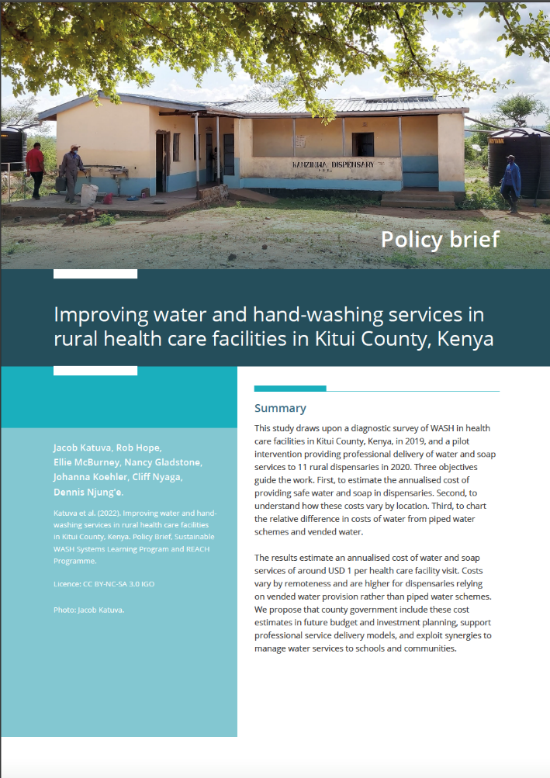
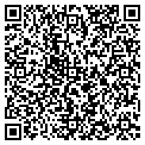
https://reachwater.org.uk/resource/improving-water-and-hand-washing-services-in-rural-health-care-facilities-in-kitui-county-kenya/

Slide 8

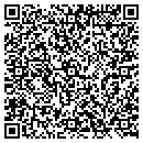
https://reachwater.org.uk/resource/investing-in-professionalized-maintenance-to-increase-social-and-economic-returns-from-drinking-water-infrastructure-in-rural-kenya/

